Slide 1

Scalable Data Analytics Using R: Single Machines to Spark Clusters
John-Mark Agosta, Hang Zhang, Robert Horton, Mario Inchiosa, Srini Kumar, Mengyue (Katherine) Zhao, Vanja Paunic and Debraj GuhaThakurta
Microsoft
TUTORIAL MATERIAL & SLIDES: tinyurl.com/KDD2016R
ROOM: Embarcadero
Parc 55 San Francisco,
55 Cyril Magnin St, San Francisco, CA
TIME: 9:00am - 12:00pm
August 17th, 2016, KDD 2016, San Francisco
2016

Slide 2
Tutorial Outline
Introduction - scaling your R scripts (issues and solutions)
Hands-on tutorial (end-to-end scalable data analysis in R)
Practical examples and case studies
Q&A

Slide 3
Introduction
What is R?
What limits the scalability of R scripts?
What functions and techniques can be used to overcome those limits?
How do the base and scalable approaches compare?

Slide 4

What is
Language
Platform
The most popular statistical programming language
A data visualization tool
Open source
Community
2.5+M users
Taught in most universities
New and recent grad’s use it
Thriving user groups worldwide
Ecosystem
8000+ contributed packages
Rich application & platform integration

Slide 5
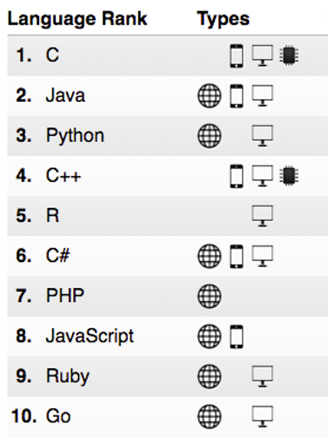
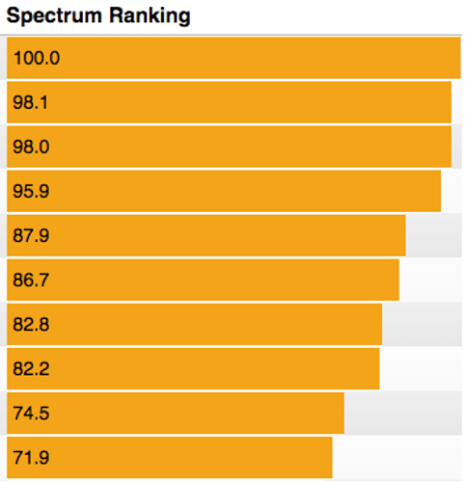
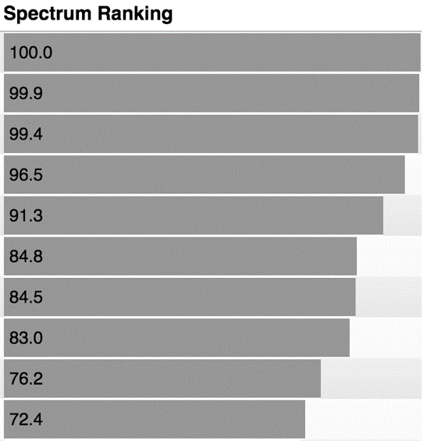
R ranks #5 in IEEE Spectrum July 2016
2016
2015

Slide 6
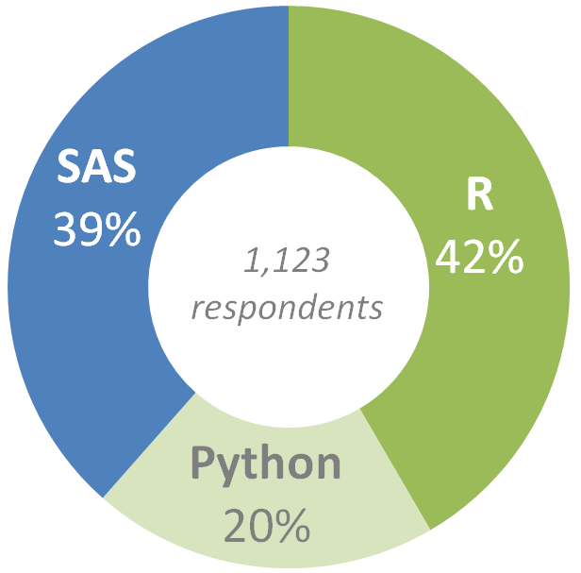
Preferred language by Analytics Pros
Which do you prefer to use: SAS, R, or Python?
Source: SAS, R or Python Survey 2016, by Burtch Works

Slide 7
Common R use cases
Vertical | Sales & Marketing | Finance & Risk | Customer & Channel | Operations & Workforce
Retail | Demand Forecasting Loyalty Programs Cross-sell & Upsell Customer Acquisition | Fraud Detection Pricing Strategy | Personalization Lifetime Customer Value Product Segmentation | Store Location Demographics Supply Chain Management Inventory Management
Financial Services | Customer Churn Loyalty Programs Cross-sell & Upsell Customer Acquisition | Fraud Detection Risk& Compliance Loan Defaults | Personalization Lifetime Customer Value | Call Center Optimization Pay for Performance
Healthcare | Marketing Mix Optimization Patient Acquisition | Fraud Detection Bill Collection | Population Health Patient Demographics | Operational Efficiency Pay for Performance
Manufacturing | Demand Forecasting Marketing mix Optimization | Pricing Strategy Perf Risk Management | Supply Chain Optimization Personalization | Remote Monitoring Predictive Maintenance Asset Management

Slide 8
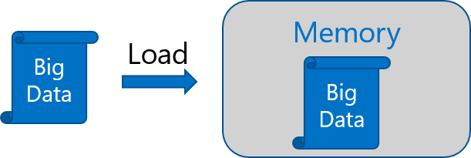
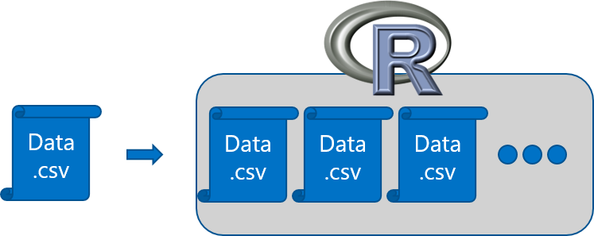
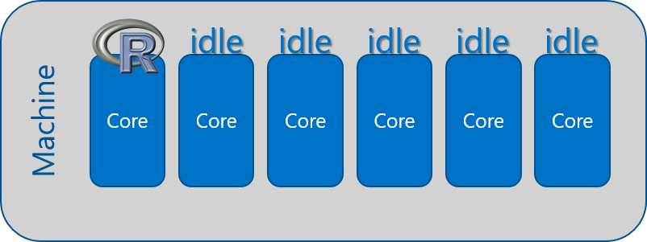
R adoption is on a Tear
In-Memory Operation
Expensive Data Movement
& Duplication
Lack of Parallelism

Slide 9



Open source R is not enterprise class
Inadequacy of Community Support
Lack of Guaranteed Support Timeliness
No SLAs or Support Models

Slide 10
Couple of scalable R solutions
Choose R packages with big data support on single machines
The “bigmemory” project
“ff” and related packages
Scale from single machines to distributed computing
SparkR
sparklyr
RevoScaleR (Microsoft R Server)
and more!

Slide 11
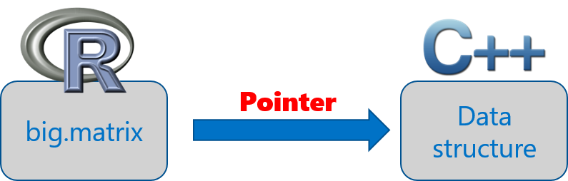
The bigmemory project
Coined by Michael Kane and John Emerson at Yale University
“bigmemory” works with massive matrix-like objects in R
Combines memory and file-backed data structures: analyze numerical data larger than RAM
The data structures may be allocated to shared memory
Source: “The Bigmemory Project” by Michael Kane and John Emerson: April 29, 2010.

Slide 12
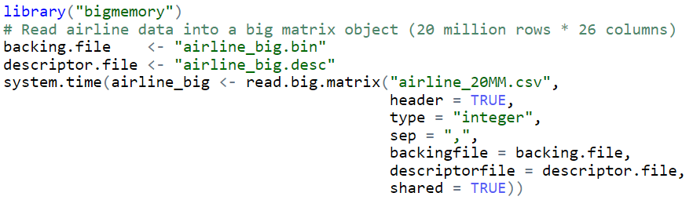
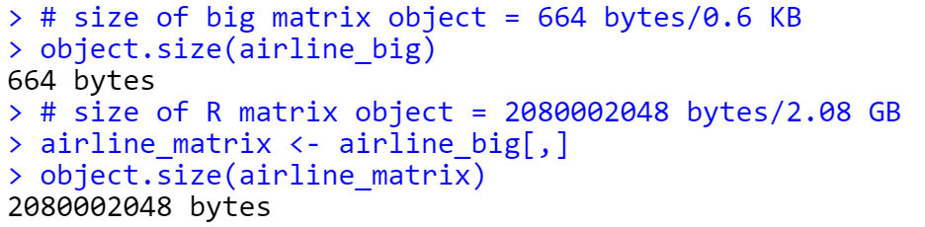
Brings a small object into memory
Imports a 20 million rows * 26 columns numerical matrix
big.matrix object is much smaller than its corresponding R matrix

Slide 13
Sister packages and related work
Set of packages that extends the R programming environment
biganalytics: provides exploratory data analysis functionality on big.matrix
bigtabulate: adds table-, tapply-, and split-like behavior for big.matrix
bigalgebra: performs linear algebra calculations on big.matrix and R matrix
synchronicity: supports synchronization and may eventually support interprocess communication (ipc) and message passing
Other related packages
biglm: provides linear and generalized linear models on big.matrix
Rdsm: enables shared-memory parallelism with big.matrix
Source: “The Bigmemory Project” by Michael Kane and John Emerson: April 29, 2010.

Slide 14
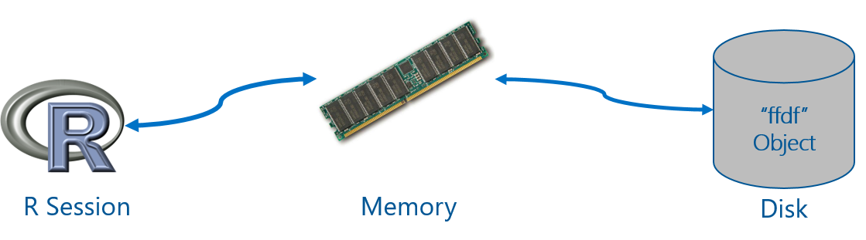
“ff” package
Provides data structures that are stored on Disk, but behave as if they were in RAM
Maps only a section in main memory for effective consumption
Accepts numeric and characters as input data
Source: ff: memory-efficient storage of large data on disk and fast access functions.

Slide 15
ffdf separates virtual from physical storage
data.frame(matrix)
ffdf(ff_matrix)
matrix
ff_matrix
physically not copied (default)
copied to vectors
virtually mapped
Source: Managing data.frames with package 'ff' and fast filtering with package 'bit‘, by Oehlschlägel, Adler (2009).

Slide 16
“ff” related packages
ffbase: adds basic statistical functionality to ff. (Note: *.ff apply on ff vectors, and *.ffdf apply on ffdf.)
Coercions: as.character.ff(), as.Date_ff_vector(), as.ffdf.ffdf(), as.ram.ffdf()
Selections: subset.ffdf(), ffwhich(), transform.ffdf(), within.ffdf(), with.ffdf()
Aggregations: quantile.ff(), hist.ff(), sum.ff(), mean.ff(), range.ff(), tabulate.ff()
Algorithms: bigglm.ffdf()
biglars: provides least-angle regression, lasso and stepwise regression on ff.
Source: CRAN Task View: High-Performance and Parallel Computing with R, by Dirk Eddelbuettel.

Slide 17
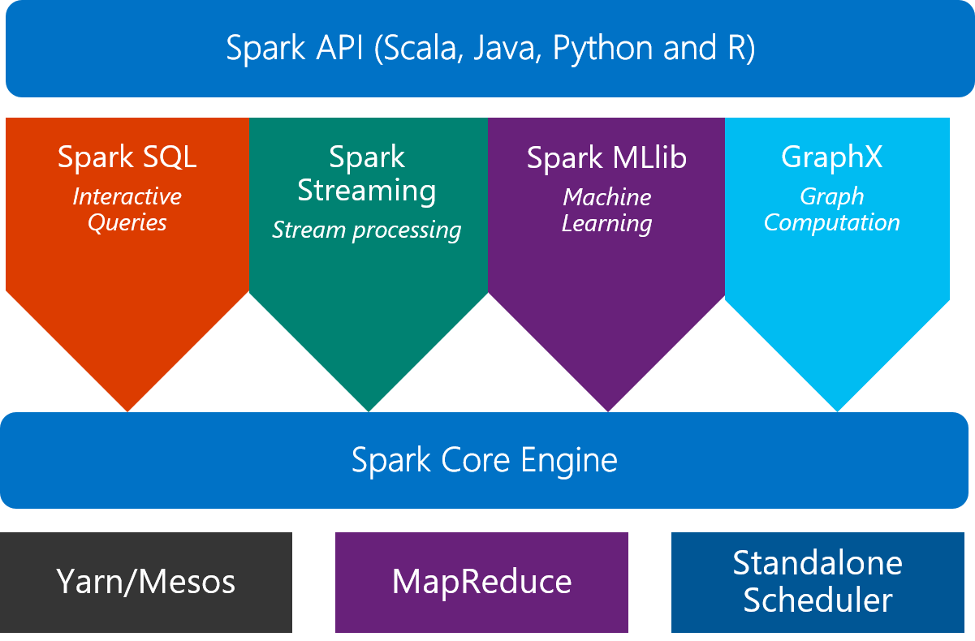
From single machines to distributed computing
Scale on Spark clusters is one approach
What is Spark?
An unified, open source, parallel, data processing framework for Big Data Analytics

Slide 18
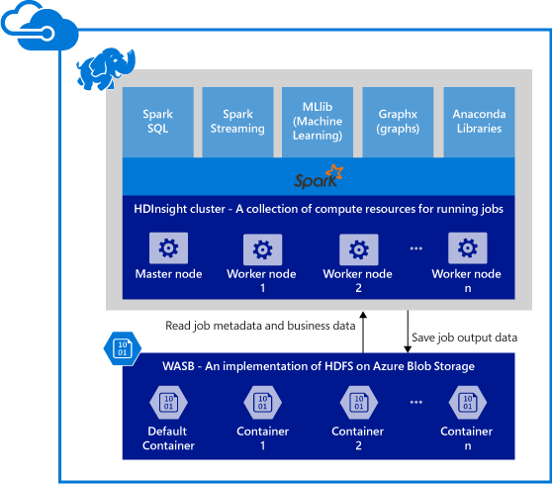
Spark clusters in Azure HDInsight
Provisions Azure compute resources with Spark 1.6 installed and configured.
Data is stored in Azure Blob storage (WASB).

Slide 19

SparkR 1.6: a Spark API
An R package provides a light-weight frontend to use Apache Spark from R and allows data scientists to analyze large datasets.
Spark DataFrame is distributed collection of data organized into named columns.
With SQLContext, SparkR can create Spark DataFrames from local R data frames, csv, json and parquet files.
Using HiveContext, it can also access tables from Hive MetaStore.
Pre-configured on Spark clusters in HDInsight.

Slide 20
Data processing and modeling with SparkR
Supports functions for structured data processing:
Selections: select(), filter()
Aggregations: summarize(), arrange()
Applying UDFs on each partition of a SparkDataFrame: available in SparkR 2.0!
dapply(), dapplyCollect(), gapply(), gapplyCollect()
Uses MLlib to fit generalized linear models over SparkDataFrames
More algorithms and model persistence are included in SparkR 2.0
Accelerated Failure Time (AFT) Survival Regression Model
Naive Bayes Model
KMeans Model

Slide 21
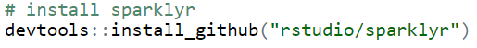
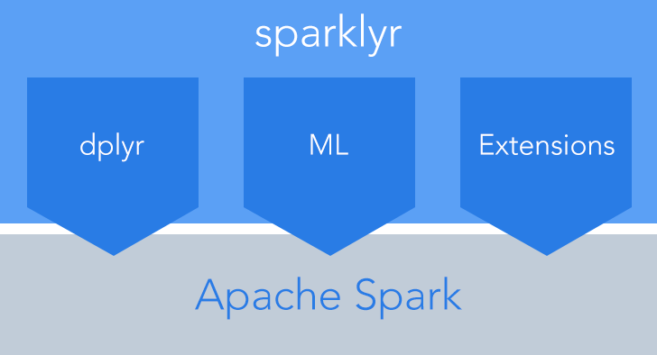
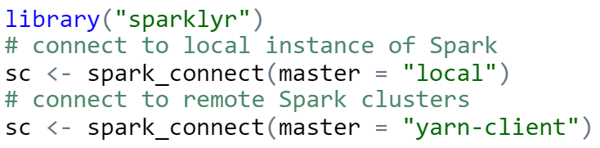
sparklyr: R interface for Apache Spark
Easy installation via devtools
Connect to both local instances of Spark and remote Spark clusters
Loads data into Spark DataFrames from: local R data frames, Hive tables, CSV, JSON, and Parquet files.
Source: http://spark.rstudio.com/

Slide 22
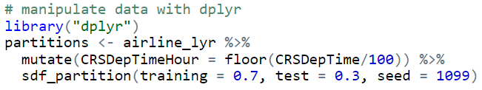
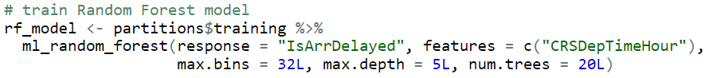
dplyr and ML in sparklyr
Provides a complete dplyr backend for data manipulation, analysis and visualization
%>%
Includes 3 family of functions for machine learning pipeline
ml_*: Machine learning algorithms for analyzing data provided by the spark.ml package.
K-Means, GLM, LR, Survival Regression, DT, RF, GBT, PCA, Naive-Bayes, Multilayer Perceptron
ft_*: Feature transformers for manipulating individual features.
sdf_*: Functions for manipulating SparkDataFrames.

Slide 23
R Server: scale-out R, Enterprise Class!
100% compatible with open source R
Any code/package that works today with R will work in R Server.
Ability to parallelize any R function
Ideal for parameter sweeps, simulation, scoring.
Wide range of scalable and distributed “rx” pre-fixed functions in “RevoScaleR” package.
Transformations: rxDataStep()
Statistics: rxSummary(), rxQuantile(), rxChiSquaredTest(), rxCrossTabs()…
Algorithms: rxLinMod(), rxLogit(), rxKmeans(), rxBTrees(), rxDForest()…
Parallelism: rxSetComputeContext()

Slide 24










Parallelized & Distributed Analytics
ETL
Statistical Tests
Machine Learning
Data import – Delimited, Fixed, SAS, SPSS, OBDC
Variable creation & transformation
Recode variables
Factor variables
Missing value handling
Sort, Merge, Split
Aggregate by category (means, sums)
Chi Square Test
Kendall Rank Correlation
Fisher’s Exact Test
Student’s t-Test
Decision Trees
Decision Forests
Gradient Boosted Decision Trees
Naïve Bayes
Predictive Statistics
Clustering
Sum of Squares (cross product matrix for set variables)
Multiple Linear Regression
Generalized Linear Models (GLM) exponential family distributions: binomial, Gaussian, inverse Gaussian, Poisson, Tweedie. Standard link functions: cauchit, identity, log, logit, probit. User defined distributions & link functions.
Covariance & Correlation Matrices
Logistic Regression
Predictions/scoring for models
Residuals for all models
K-Means
Descriptive Statistics
Sampling
Min / Max, Mean, Median (approx.)
Quantiles (approx.)
Standard Deviation
Variance
Correlation
Covariance
Sum of Squares (cross product matrix for set variables)
Pairwise Cross tabs
Risk Ratio & Odds Ratio
Cross-Tabulation of Data (standard tables & long form)
Marginal Summaries of Cross Tabulations
Subsample (observations & variables)
Random Sampling
Simulation
Simulation (e.g. Monte Carlo)
Parallel Random Number Generation
Custom Parallelization
Variable Selection
rxDataStep
rxExec
PEMA-R API
Stepwise Regression

Slide 25
Portable across multiple platforms
Windows
Linux
HDInsight
Cloud
Hortonworks
Cloudera
MapR
Hadoop & Spark
R Server Technology
R Server portfolio
EDW
SQL Server 2016
Teradata Database
R+CRAN
Microsoft R Open
DeployR
DistributedR
RDBMS
SQL Server 2016 EE
SQL Server 2016 SE
ConnectR
Desktops & Servers
Windows
Linux
ScaleR

Slide 26
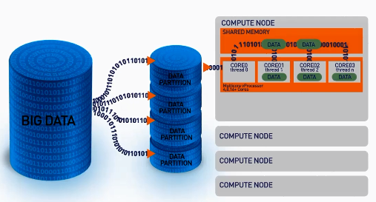
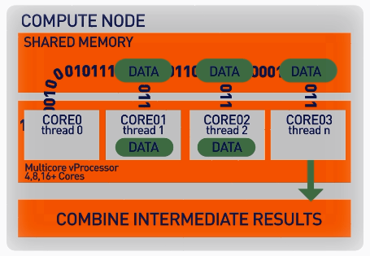
ScaleR: parallel + Big Data
Our ScaleR algorithms work inside multiple cores / nodes in parallel at high speed
Stream data into RAM in blocks. “Big Data” can be any data size. We handle Megabytes to Gigabytes to Terabytes…
Interim results are collected and combined analytically to produce the output on the entire data set
XDF file format is optimised to work with the ScaleR library and significantly speeds up iterative algorithm processing.

Slide 27
Write Once - Deploy Anywhere
ScaleR models can be deployed from a server or edge node to run in Spark/Hadoop without any functional R model re-coding.
Local Parallel processing - Linux or Windows
In – Spark/Hadoop
### SETUP LOCAL ENVIRONMENT VARIABLES ###
myLocalCC <- “localpar”
### LOCAL COMPUTE CONTEXT ###
rxSetComputeContext(myLocalCC)
### CREATE LINUX, DIRECTORY AND FILE OBJECTS ###
linuxFS <- RxNativeFileSystem( )
AirlineDataSet <- RxXdfData(“airline_20MM.xdf”,
fileSystem = linuxFS)
### SETUP SPARK/HADOOP ENVIRONMENT VARIABLES ###
mySparkCC <- RxSpark() myHadoopCC <- RxHadoopMR()
### HADOOP COMPUTE CONTEXT ###
rxSetComputeContext(mySparkCC) rxSetComputeContext(myHadoopCC)
### CREATE HDFS, DIRECTORY AND FILE OBJECTS ###
hdfsFS <- RxHdfsFileSystem()
AirlineDataSet <- RxXdfData(“airline_20MM.xdf”, fileSystem = hdfsFS)
Compute context R script - sets where the model will run
Functional model R script – does not need to change to run in Spark
### ANALYTICAL PROCESSING ###
### Statistical Summary of the data
rxSummary( ~ ArrDelay + DayOfWeek, data = AirlineDataSet, reportProgress = 1)
### CrossTab the data
rxCrossTabs(ArrDelay ~ DayOfWeek, data = AirlineDataSet, means = T)
### Linear model and plot
hdfsXdfArrLateLinMod <- rxLinMod(ArrDelay ~ DayOfWeek + CRSDepTime, data = AirlineDataSet)
plot(hdfsXdfArrLateLinMod$coefficients)

Slide 28
Base and scalable approaches comparison
Approach | Scalability | Spark | Hadoop | SQL | Teradata | Support
CRAN R1 | Single machines |  |  |  |  | Community
bigmemory | Single machines |  |  |  |  | Community
ff | Single machines |  |  |  |  | Community
SparkR | Single + Distributed computing | X |  | X |  | Community
sparklyr | Single + Distributed computing | X |  | X |  | Community
RevoScaleR | Single + Distributed computing | X | X | X | X | Enterprise
CRAN R indicates no additional R packages installed

Slide 29
R Server on Spark - faster and more scalable
Configuration:
HDI cluster size: 7 nodes
1 Edge Node: 8 cores, 28GB
4 Worker Nodes: 8 cores, 28GB
Dataset: Duplicated Airlines data (.csv)
Number of columns: 26

Slide 30
R Server on Spark - substantially faster
Configuration:
HDI cluster size: 7 nodes
1 Edge Node: 8 cores, 28GB
4 Worker Nodes: 8 cores, 28GB
Dataset: Duplicated Airlines data (.csv)
Number of columns: 26

Slide 31
Hands-on tutorial
End to end scalable data analysis in R: Data exploration, visualization, modeling and deployment using distributed R functions and Spark
Scalable analysis on single nodes
Integrated analytics in Spark: Data exploration, distributed training and deployment of machine learning models

Slide 32
Demo

Slide 33
Practical examples and case studies
Exploration and visualization using SparkSQL and R
Parallel models: training many parallel models for hierarchical time series optimization
Distributed model training and parameter optimization: Learning Curves on Big Data
Overview of open libraries of R templates and examples

Slide 34
Demo

Slide 35
Overview of open libraries of R templates
Tutorial material and slides are available: tinyurl.com/KDD2016R
R Server for Machine Learning examples: tinyurl.com/2016MRS4ML

Slide 36
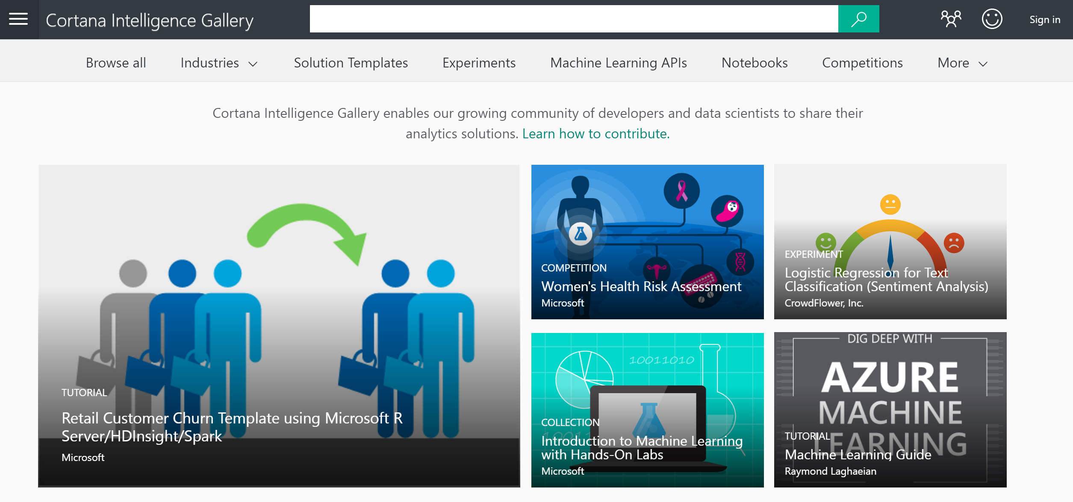
Cortana Intelligence Gallery

Slide 37
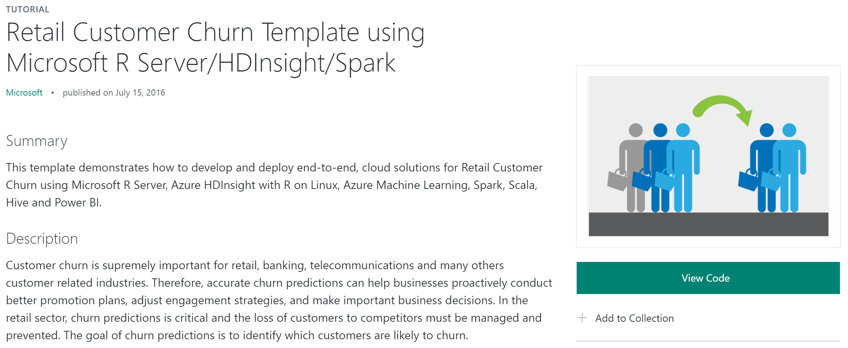
An end-to-end solution with R Server and Spark

Slide 38








Scale on big data - R Server + Azure
Data Streaming
Data Sources
Data Partition
Model Training
Web Services
Consumption
Feature Engineering
Predictions
HDInsight
Web Application
Azure Stream Analytics
Azure Blob Storage
Microsoft R Server
Azure Machine Learning
Power BI

Slide 39
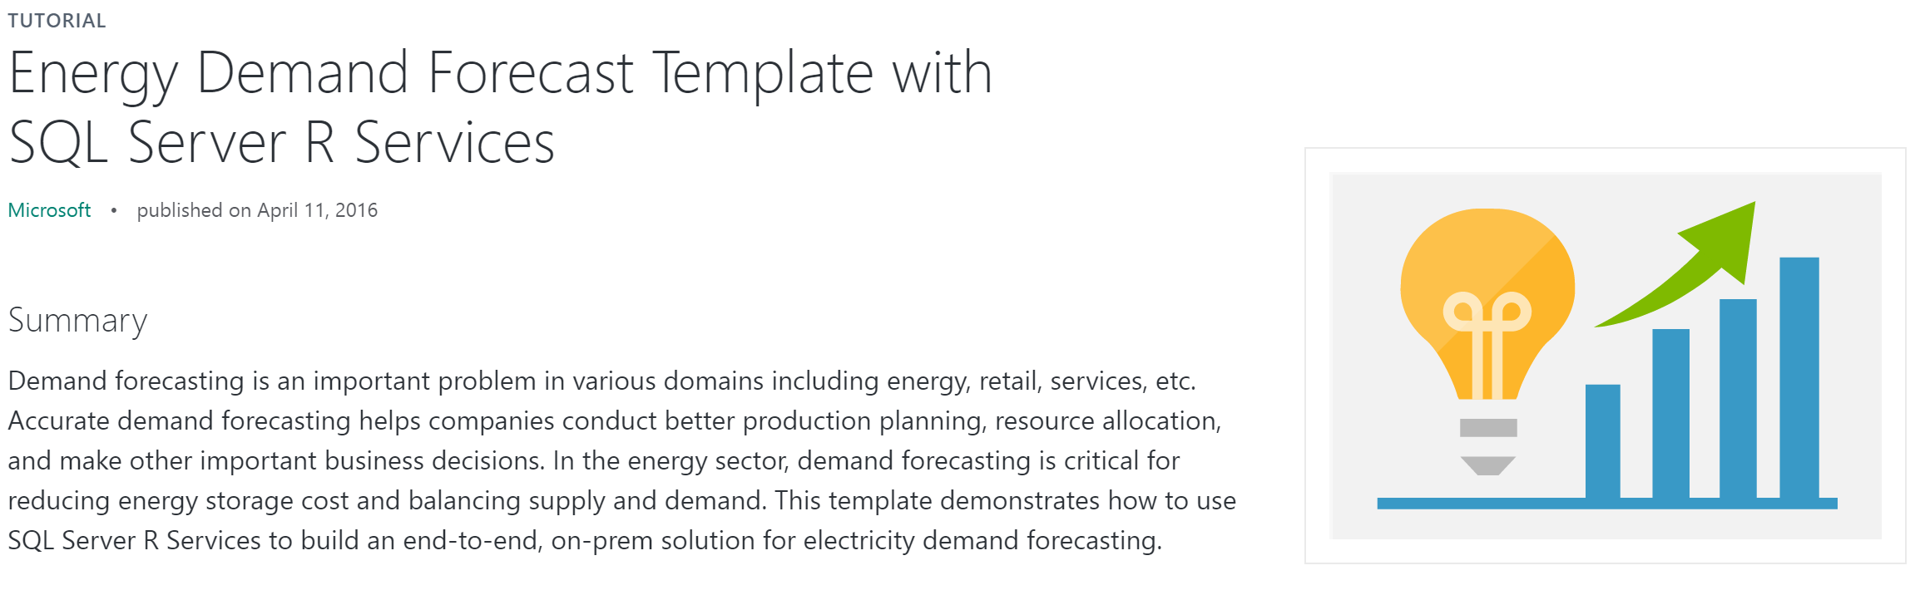
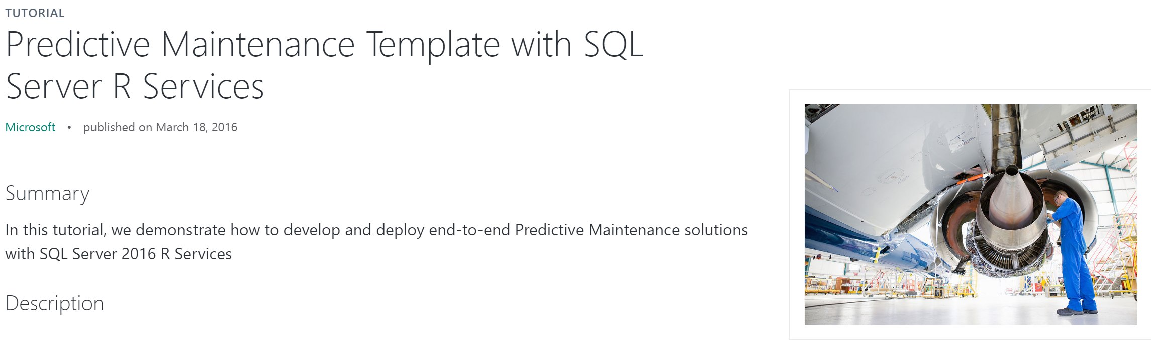
End-to-end solutions with SQL Server R Services

Slide 40
Q&A

Slide 41
THANK YOU

